Slide 1


It's time!👊🏽
Main Event Matchmaking Executive Pitch

Slide 2
Addressing Revenue Decline: Strategic Event Planning for UFC’s Future
UFC Q1 and Q2 Revenue has been lower than in previous years
Tasked with planning and pitching a main event and backup/co-main event for final five events
Given event data from 1994-2021 from Kaggle UFC Master Dataset
Balancing fighter payouts and operational costs remains a key challenge for maintaining profitability.
Global expansion and localized marketing are needed to maximize audience reach and revenue potential.
Data-driven strategies and digital fan engagement are increasingly critical for event success.

Slide 3
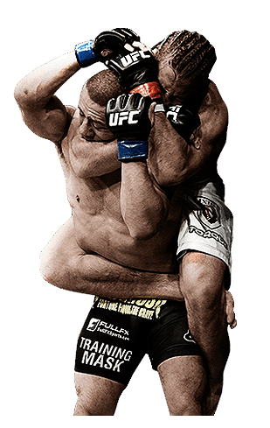
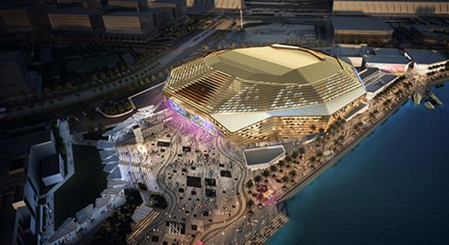

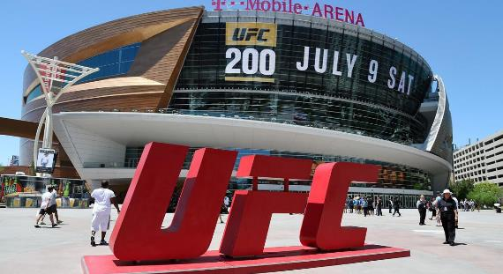
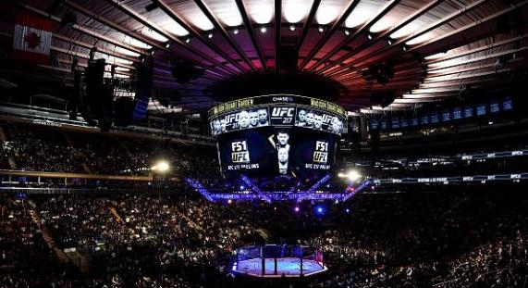
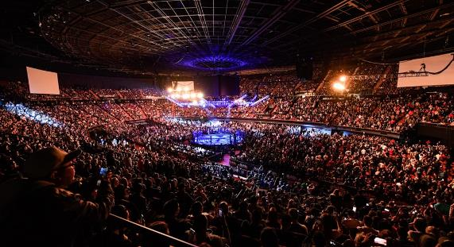
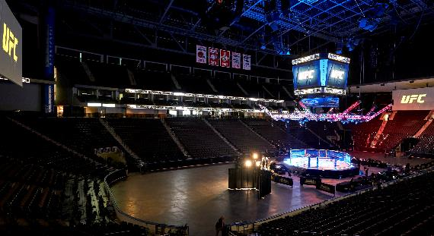
Battle Across Borders: UFC’s World-Class Event Destinations
Etihad Arena, Abu Dhabi
T-Mobile Arena, Las Vegas
Madison Square Garden, New York
The O2 Arena, London
Jeunesse Arena, Rio de Janeiro

Slide 4

Fight Night Formula: Parameters for Event Success
Each bout features two marquee fighters, building new rivalries and storylines.
No repeat matchups, every fight is fresh, using detailed historical data (as of 2021) for eligibility.
Weight classes: Fighters compete in the same or one adjacent class, maximizing competitive balance.
Spotlight on current stars as well as popular retired athletes (eligible if retired within the past 3 years).
Event Selection Highlights
Rigorous criteria ensure every card delivers excitement, fairness, and market appeal.
Locations chosen for maximum international reach and audience impact

Slide 5




Main Event Matchups: Balancing High Stakes & Big Rewards
Location & Venue | Fight Card | Weight Class | Reward tier | Risk Tier
Madison Square Garden, New York | (Main) Jon Jones vs. Sergei Pavlovich | Heavyweight | High | High
 | (Co-main) Colby Covington vs. Shavkat Rakhmonov | Welterweight
Etihad Arena, Abu Dhabi | (Main) Khamzat Chimaev vs. Sean Strickland | Middleweight | High | High
 | (Co-main) Islam Makhachev vs. Beneil Dariush | Lightweight | High | Low
T-Mobile Arena, Las Vegas | (Main) Justin Gaethje vs. Rafael Fiziev | Lightweight | High | Medi
 | (Co-main) Dustin Poirier vs. Arman Tsarukyan | Lightweight | High | Low
The O2 Arena, London | (Main) Leon Edwards vs. Belal Muhammad | Welterweight
 | (Co-main) Tom Aspinall vs. Curtis Blaydes | Heavyweight |  | Low
Jeunesse Arena, Rio de Janeiro | (Main) Amanda Nunes vs. Irene Aldana | Women's Bantamweight
 | (Co-main) Deiveson Figueiredo vs. Petr Yan | Flyweight vs Bantamweight |  | Low
- High risk, - Medium risk, , - safe bet - high reward, - medium reward

Slide 6
Matchmaking Metrics: The Formula Behind the Fight
Metrics | Weight | Normalized Score
Win Rate | 35% | 0.78
Total Fights | 25% | 0.78
Finishes(KO/TKO) | 25% | 0.90
Significant Strikes | 10% | 0.80
Metrics | Weight | Normalized Score
Win Rate | 35% | 0.73
Total Fights | 25% | 0.80
Finishes(KO/TKO) | 25% | 0.83
Significant Strikes | 10% | 0.71
Fighter 1
Fighter 2
Popularity Index _{Fighter 1} = (0.35*0.78) + (0.25*0.76) + (0.25*0.90) + (0.10*0.80) = 0.77
Popularity Index _{Fighter 2} = (0.35*0.73) + (0.25*0.80) + (0.25*0.83) + (0.10*0.71) = 0.73
Combined Popularity Index = PI _{Fighter 1} + PI _{Fighter 2} = 1.5

Slide 7

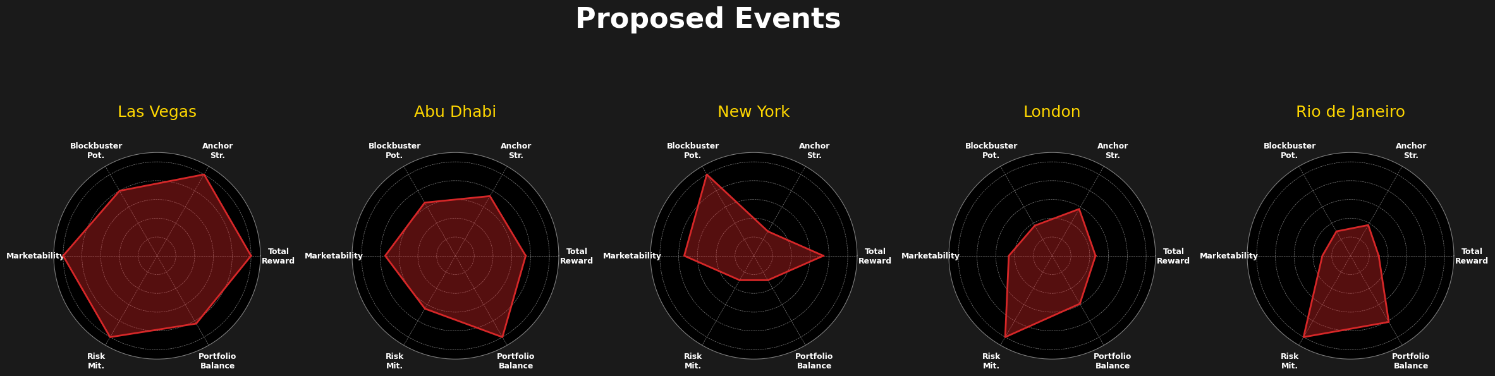
Unleashing Potential: Comparative Event Analysis
Las Vegas: Highest Total Reward and Anchor Strength, strong expected PPV sales from Anchor.
New York: Highest Blockbuster Potential, but lowest Portfolio Balance (large PPV disparity) and lowest Risk Mitigation (higher risk).
Abu Dhabi: Highest Portfolio Balance (even PPV distribution) and good Marketability.
London: Moderate performance across most metrics, relatively high Risk Mitigation (lower risk).
Rio de Janeiro: Lowest Total Reward, Anchor Strength, Blockbuster Potential, and Marketability (lower expected PPV and popularity). High-Risk Mitigation and Good Portfolio Balance.
The main and co-main matches for each city have been taken into account for the event rankings.

Slide 8




Maximizing Impact: Investment & Returns Across Key UFC locations
Location | Media & Marketing ($M) | Fighter Payouts ($M) | Venue & Operations ($M) | Total Investment ($M) | Expected ROI | Expected Return ($M)
Las Vegas | 8 | 20 | 15 | 43 | 55% | 23.65
Abu Dhabi | 4 | 12 | 8 | 24 | 65% | 15.60
New York | 7 | 18 | 12 | 37 | 60% | 22.20
London | 3 | 10 | 6 | 19 | 68% | 12.92
Rio de Janeiro | 2 | 8 | 4 | 14 | 75% | 10.50

Slide 9
Thank You

Slide 10
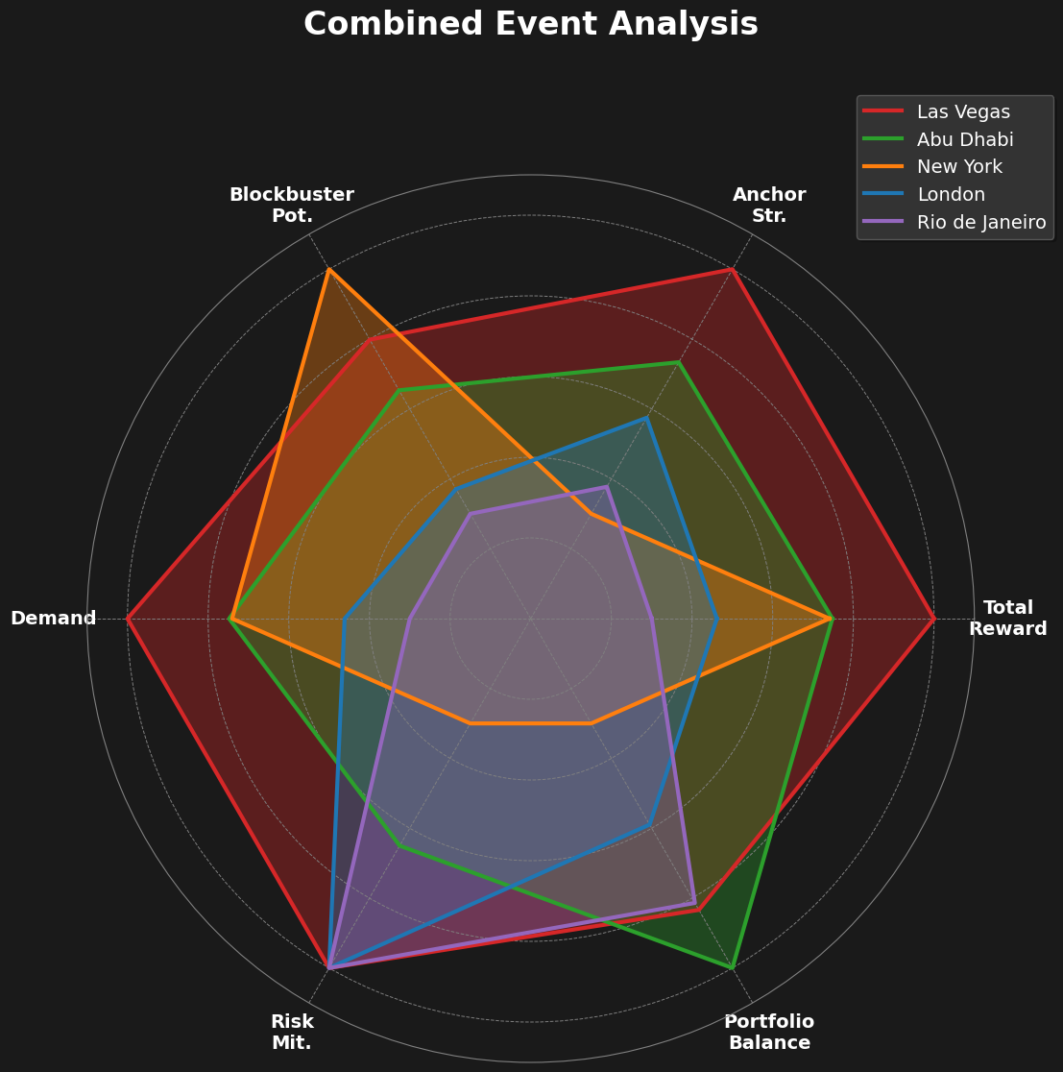
Combined graph (alternative)
Unleashing Potential: Comparative Event Analysis
Las Vegas: Highest Total Reward and Anchor Strength, strong expected PPV sales from Anchor.
New York: Highest Blockbuster Potential, but lowest Portfolio Balance (large PPV disparity) and lowest Risk Mitigation (higher risk).
Abu Dhabi: Highest Portfolio Balance (even PPV distribution) and good Marketability.
London: Moderate performance across most metrics, relatively high Risk Mitigation (lower risk).
Rio de Janeiro: Lowest Total Reward, Anchor Strength, Blockbuster Potential, and Marketability (lower expected PPV and popularity). High-Risk Mitigation and Good Portfolio Balance.
The main and co-main matches for each city have been taken into account for the event rankings.

